Slide 1

WSUP20-0026 Bowl Incline
Washoe County Board of Adjustment
February 4, 2021

Slide 2
Request
Request for an outdoor amusement use type.
Request to expand an amusements and recreation services use type.
These use types require a Special Use Permit per the Incline Village Commercial Community Plan.

Slide 3
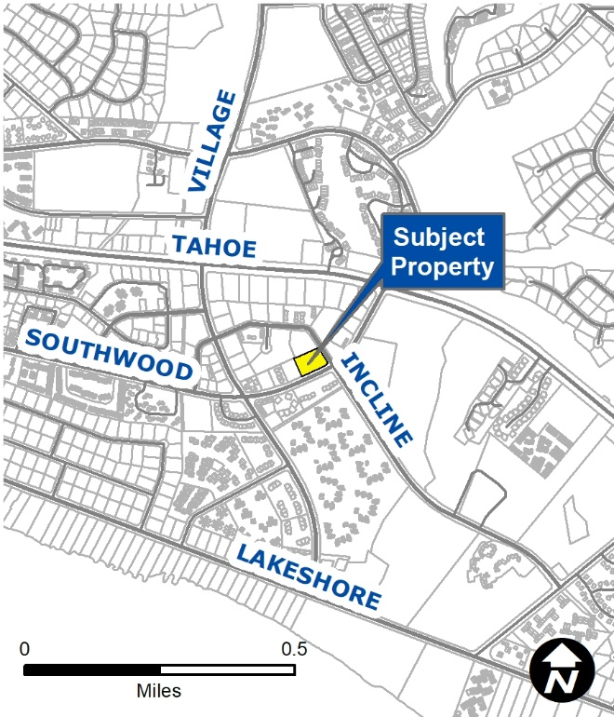
Vicinity Map
Located off Southwood Blvd. and Incline Way

Slide 4
Background
Project site consists of a developed parcel totaling ±1.18 acres.
The existing development was constructed in 1966.
Incline Bowl has held a liquor and business license since July 1, 1988.
The subject properties have a Master Plan Designation of Commercial (C) and a regulatory zone of General Commercial (GC).

Slide 5
Background
The bowling center is ±16,500 square feet and the proposed expansion of the outdoor use is 5,100 square feet
The expansion being proposed is ±31%; which requires the development to come into legal conformance with the development code.

Slide 6
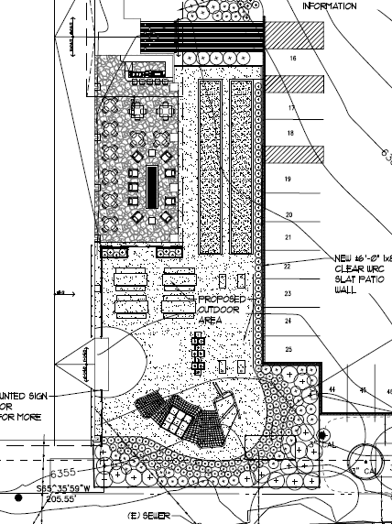
Outdoor Expansion
The outdoor expansion is proposed to include an outdoor bar and outdoor covered lounge area with privacy screening and recreational activities such as bocce ball courts.

Slide 7
Public Notice & CAB
Public notice was sent to 110 parcels
The Incline Village CAB reviewed the application on January 4, 2021 and recommended to approve the project unanimously
Discussion included noise, hours of operation, and alcohol sales within 500 feet of the middle school

Slide 8
Special Us Permit Findings
1. Consistency;
2. Improvements;
3. Site Suitability; and
4. Issuance Not Detrimental
Staff is able to make all the required findings, as detailed in the staff report

Slide 9
Possible Motion
I move that, after giving reasoned consideration to the information contained in the staff report and information received during the public hearing, the Washoe County Board of Adjustment approve with conditions Special Use Permit Case Number WSUP20-0026 for Steven and Tracy Tomkovicz, having made all five findings in accordance with Washoe County Code Section 110.810.30:

